Slide 1
TEAM : UNITED
Yatharth Bhargava
Yash Jain
Deepak Kumar Meena

Slide 2
Major Subdivisions in our Approach
Number Plate Detection from image of car
Perspective Transform
segmentation.
Prediction

Slide 3
Image of Car with
number plate
Number Plate Detection
Using Wpod Net model
Perspective Transform/Rectification
Segmentation
Prediction
Frames of video
containing car with
number plate

Slide 4
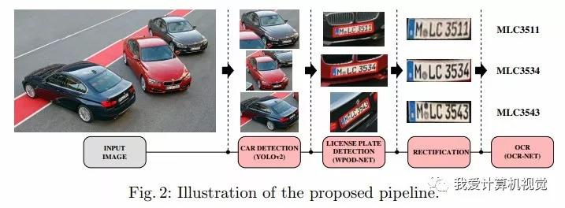
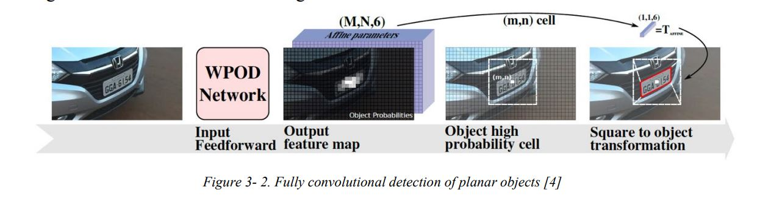
Number Plate Detection
For number plate detection we used pretrained model of WPOD - NET.
NOTE: we have used this step only when we have to detect car plate from picture of car.
Car image

Slide 5
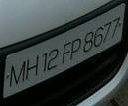
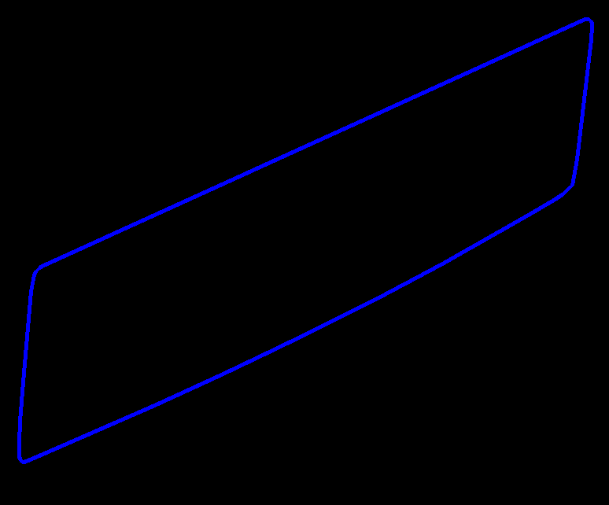
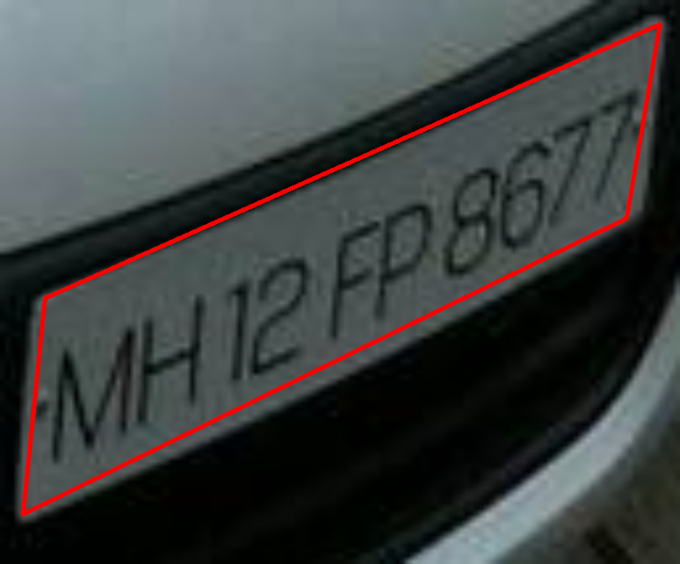
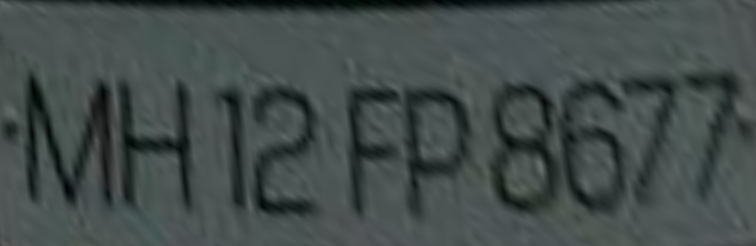
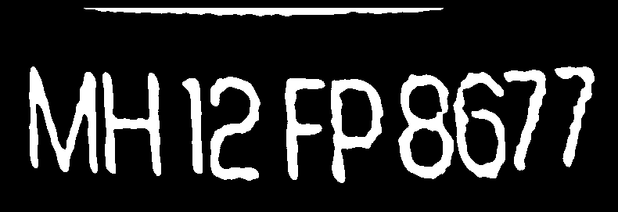


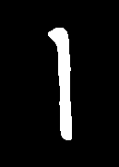




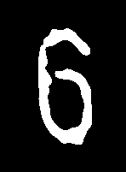
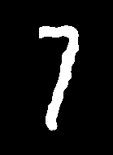
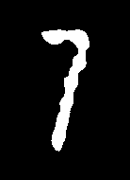
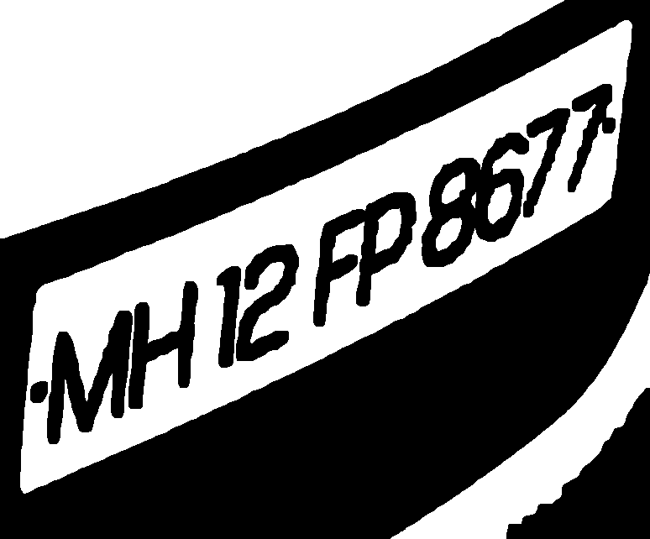

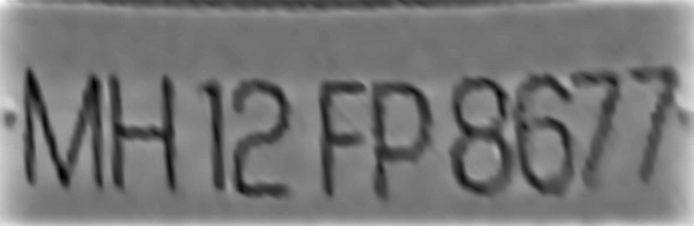
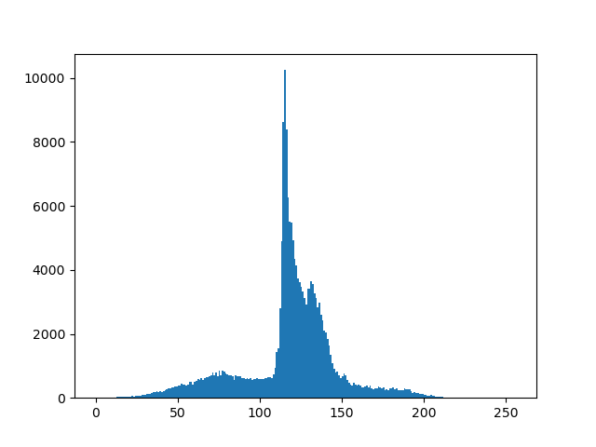
Make Quadrilateral
Using approxpolydp
On contours.
RECTIFICATION
AND SEGMENTATION
Original image Creating convex
Hull of max area
contour
Enhance Features for better Thresholding
For the next step(most important)
Thresholding from a value
which is approximately 80%
of the pixel value of which
occurs maximum
Finally denoising by simple
condition and Segmentation
Using bounding rectangle.
Apply perspective
Transform and wrap
the image
Otsu Thresholding Creating mask

Slide 6
Prediction of
Segmented Letters
We used a pretrained model whose reference we got from medium website.
They used mobilenet architecture with pre trained weight on imagenet dataset.
Link:https://medium.com/@quangnhatnguyenle/detect-and-recognize-vehicles-license-plate-with-machine-learning-and-python-part-3-recognize-be2eca1a9f12

